Slide 1
Standardized Scenarios, SRES, RCPs, SSPs, SPAs: the design and use of scenarios in modeling and policy analysis
Brian O’Neill
Joint Global Change Research Institute

Slide 2
Roadmap
What and why of scenarios
The SSP-RCP framework
Examples of applications
Issues and future directions

Slide 3
What are scenarios, why do we use them?

Slide 4
Scenarios.
A scenario is a coherent, internally consistent, and plausible description of a possible future state of the world.
Scenarios are not predictions or forecasts (which indicate outcomes considered most likely), but are alternative images without ascribed likelihoods of how the future might unfold.
They may be qualitative, quantitative, or both.
An overarching logic often relates several components of a scenario, for example a storyline and/or projections of particular elements of a system.
Carter et al., 2007. Ch 2, IPCC Fourth Assessment Report, WG2.

Slide 5
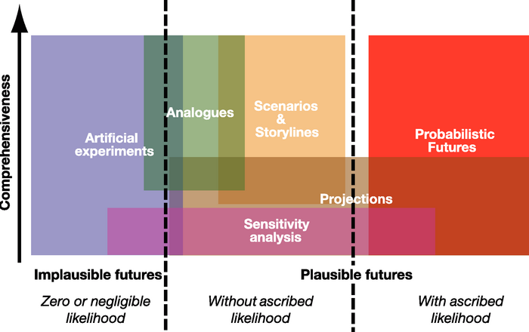
Characterizations of the future
Pathways
Prediction, Forecast
Carter et al., 2007. Ch 2, IPCC Fourth Assessment Report, WG2.

Slide 6
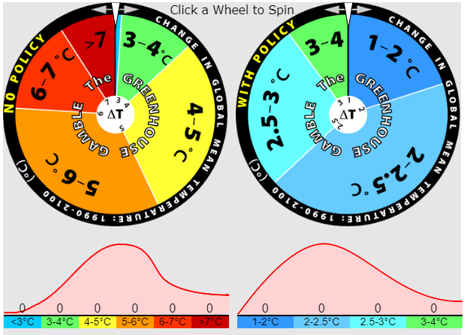
MIT “Greenhouse Gamble” (site)

Slide 7
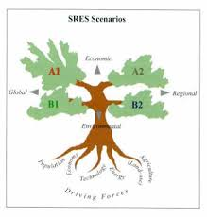
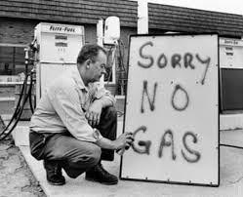
Scenario process vs. product
“Process” scenarios:
Shell 1973 Energy Scenarios foreseeing possibility of oil price shock
“Product” scenarios:
IPCC Special Report on Emissions Scenarios (SRES, 2000)

Slide 8
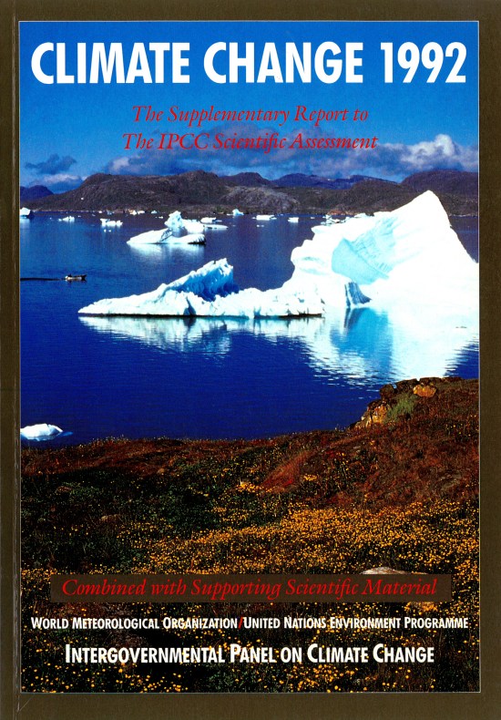
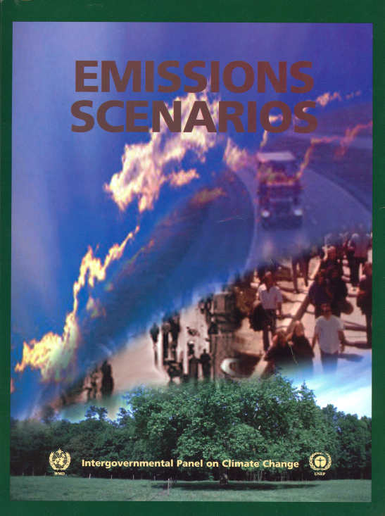
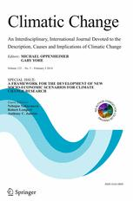
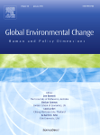
A long line of community scenarios for climate change research
SA90, 1990
IS92, 1992
Rationale:
Deep uncertainty
Facilitate integrated research and assessment
SRES, 2000
SSPs,
2014-2017
Key roles:
Frames research
Shapes scientific assessments
Science-policy interface

Slide 9
The SSP-RCP scenario framework

Slide 10

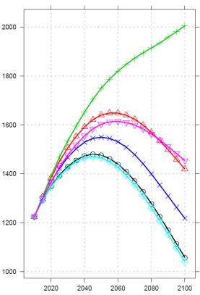
Shared Socioeconomic Pathways (SSPs)
Narrative
Qualitative description of broad patterns of development
Logic relating elements of narrative to each other
SSPs
1: Sustainability
2: Middle of the Road
3: Regional Rivalry
4: Inequality
5: Fossil-fueled Development
SSP 2
Quantitative elements
National:
Population
Education
Urbanization
GDP
SSP narratives, quantitative elements: 2017 special issue of Global Environmental Change.
SSP Database, hosted by IIASA.

Slide 11
Shared Socioeconomic Pathways (SSPs)
SSP 5: (Mit. Challenges Dominate)
Fossil-fueled Development
SSP 3: (High Challenges) Regional Rivalry
Socio-economic challenges for mitigation
SSP 2: (Intermediate Challenges) Middle of the Road
SSP 1: (Low Challenges) Sustainability
SSP 4: (Adapt. Challenges Dominate) Inequality
Socio-economic challenges for adaptation
O’Neill et al., 2017.

Slide 12
SSP Narratives
SSP 3
SSP3: Regional Rivalry
Multi-pole Cold War
Conflict, focus on security
Barriers to trade, migration
Little investment in health, education
Slow technological progress
Weak institutions
Slow income growth
SSP5: Fossil-fueled development
Rise of the global middle class
Rapid technological progress
Large investments in human well being (health, education)
Well functioning institutions
Rapid economic growth
Fossil-centered energy system
O’Neill et al., 2015.

Slide 13
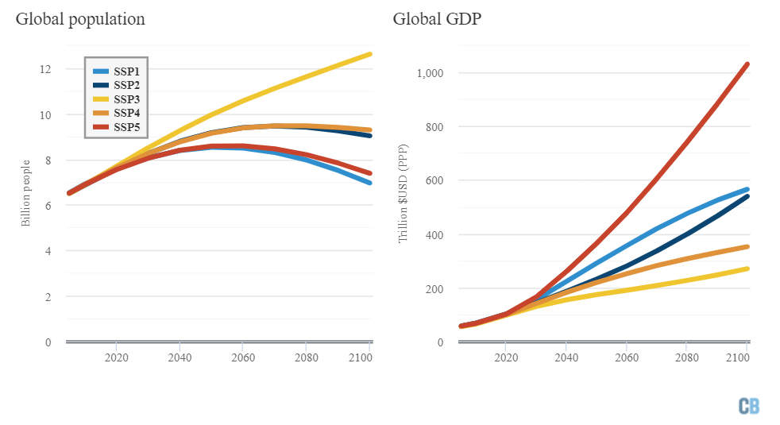
SSP global population and GDP projections
Carbon Brief, 2018, based on SSP database.

Slide 14
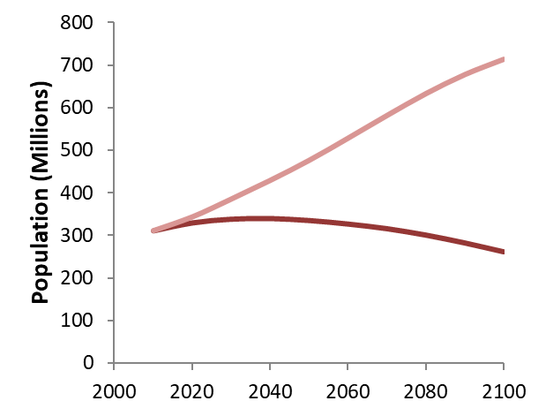
SSP Population: Asia, US
SSP3
SSP5
India
United States
China
Based on KC and Lutz, 2015.

Slide 15
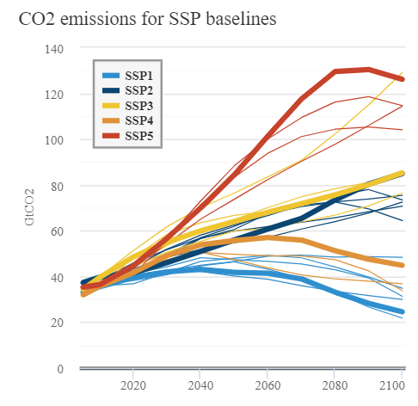
SSP-based emissions projections
SSPs 1-5
Emissions
Integrated
Assessment
Models
SSP X
Narratives
Quantitative Elements
Carbon Brief, 2018, based on SSP database.

Slide 16
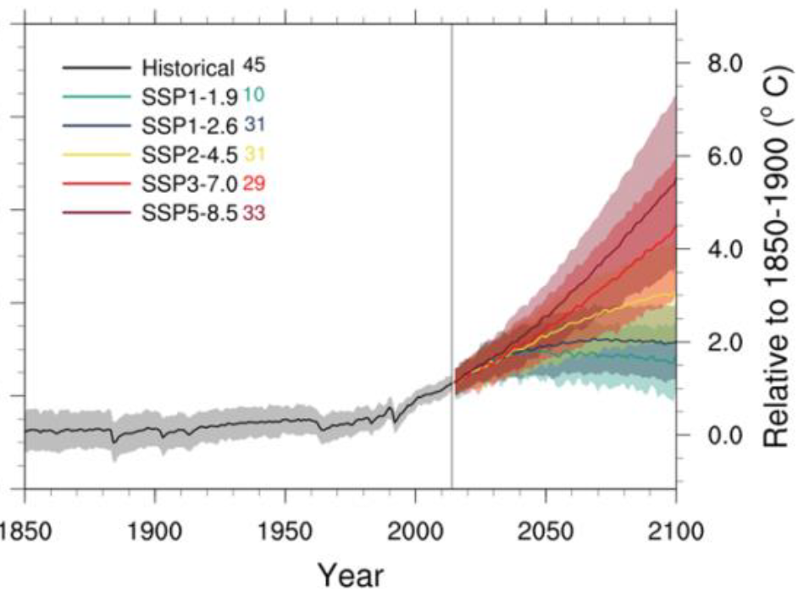
SSP-based climate projections
Radiative forcing (from concentrations)
Global Mean Temp. Change (CMIP6)
*
SSP-based concentration/ forcing pathways
*
*
*
*
Updates of original RCPs.
O’Neill et al., 2016; Riahi et al., 2017.
Tebaldi et al., 2020.

Slide 17
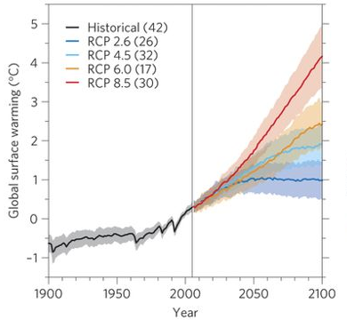
Representative Concentration Pathways (RCPs)
Radiative forcing (from concentrations)
Global Mean Temp. Change (CMIP5)
RCP8.5
RCP8.5
RCP6.0
RCP6.0
RCP4.5
RCP4.5
RCP2.6
RCP2.6
2
van Vuuren et al., 2011.
Knutti & Sedlacek, 2012.

Slide 18
The “matrix architecture”
Shared Socioeconomic Pathways
SSP1 Sustainability
SSP2 Middle of the Road
SSP3 Regional Rivalry
SSP4 Inequality
SSP5 Fossil-fueled Development
8.5
7.0
Original RCP levels
Climate
6.0
2100 forcing level (W/m²)
4.5
3.4
2.6
1.9

Slide 19
Applications of the framework

Slide 20
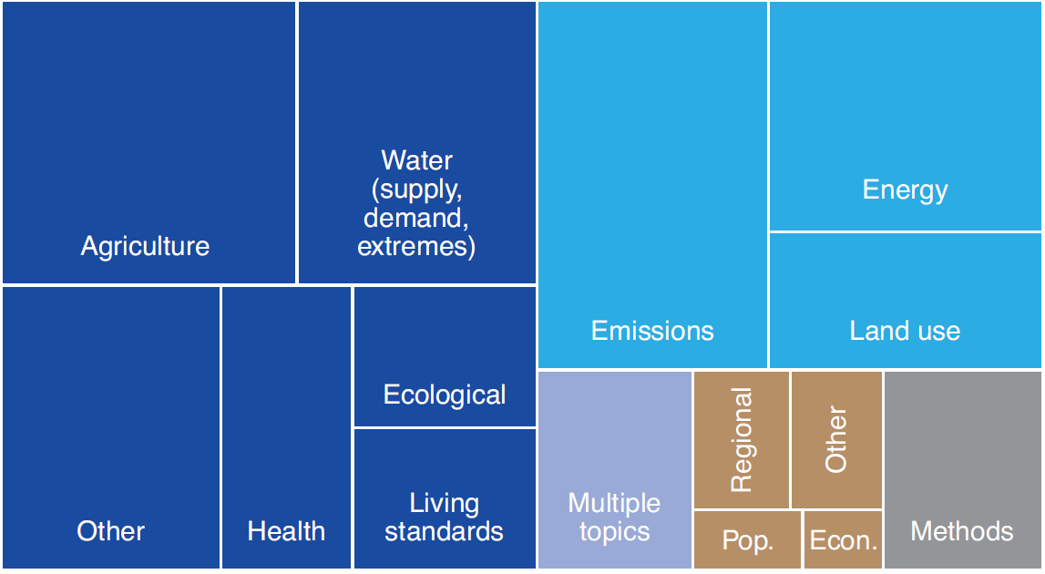
SSP applications in the literature, 2012-2019
~1900 total analyses through 2021
Use SSPs, in some cases RCPs as well
Categorized by primary topic of focus
O’Neill et al., 2020

Slide 21
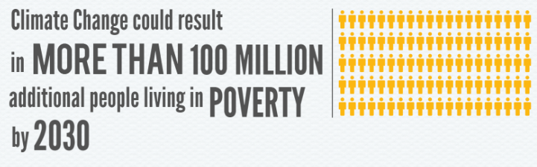
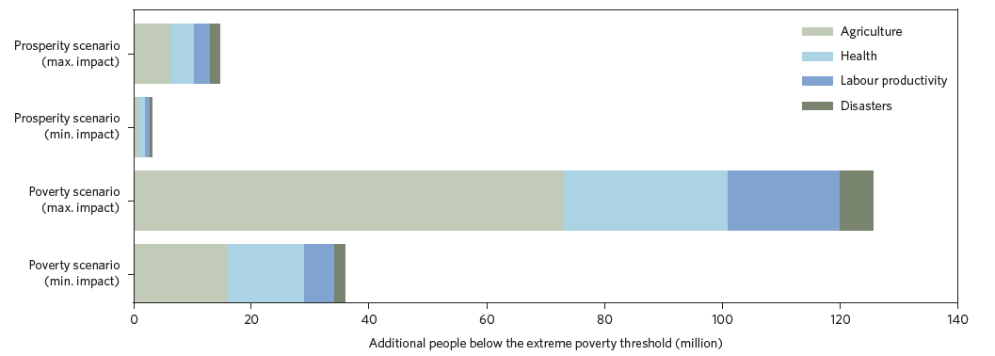
Example application (resilience matters!)
Key SSP elements
Education
Sectoral shift
Income distribution
Conclusion
Resilience critical to climate change risk
Hallegatte & Rozenberg, 2017.
High Impact
Prosperity (SSP5)
Low Impact
High Impact
Poverty (SSP4)
Low Impact
Additional people below extreme poverty threshold, 2030

Slide 22
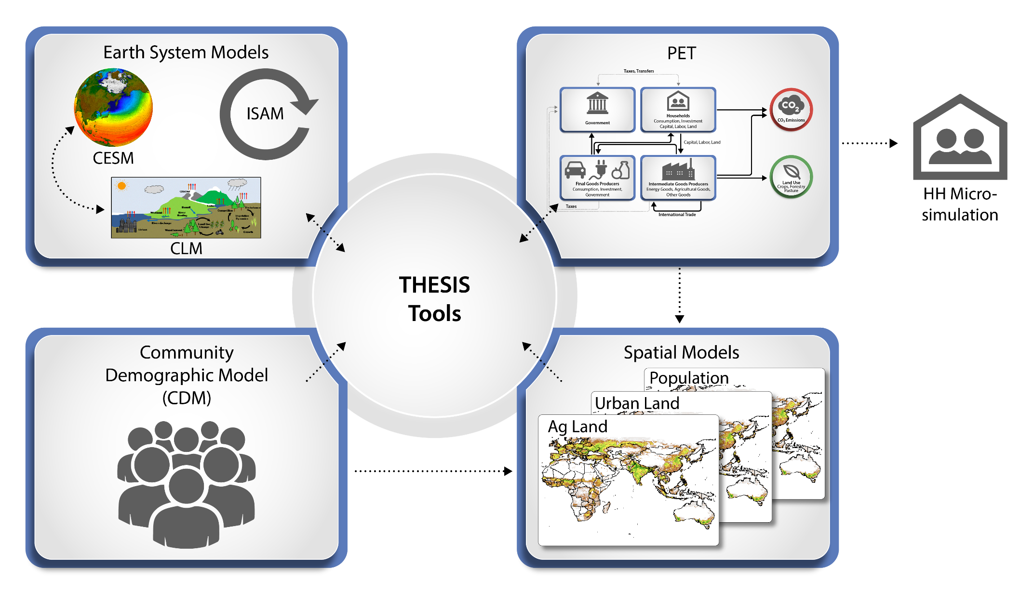
Integrated climate-society research
RCPs
SSPs
iPETS integrated assessment model framework
Key studies: O’Neill et al., 2010, 2012, 2020; Ren et al., 2016, 2018; Dalton et al., 2008.

Slide 23
Agricultural impacts: climate or society?
Climate effect dominates
Societal effect dominates
Crop yields
Crop prices
Houston heat-related mortality
US exposure, dangerous heat waves
Global exposure, heat wave days
Global exposure, dengue vector
Ratio of Societal (SSP) Effect to Climate (RCP) Effect
2061-2080
Ren et al., 2016; O’Neill et al., 2017.

Slide 24
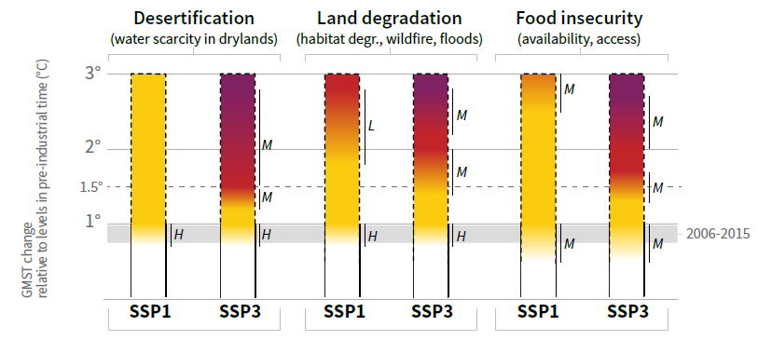
IPCC food security risk assessment
IPCC Special Report on Climate Change and Land (2019)
(Low vulnerability)
(High vulnerability)

Slide 25
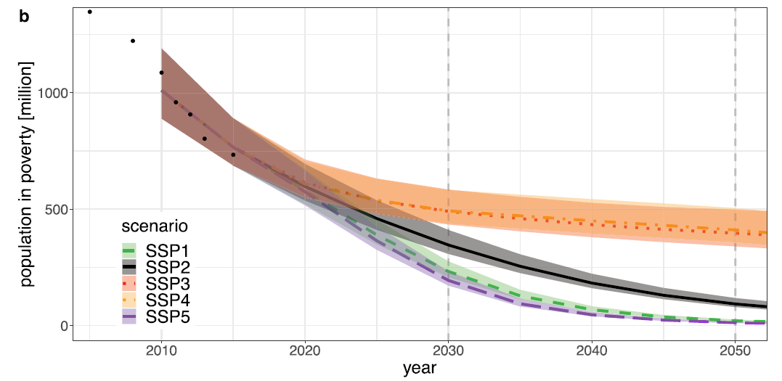
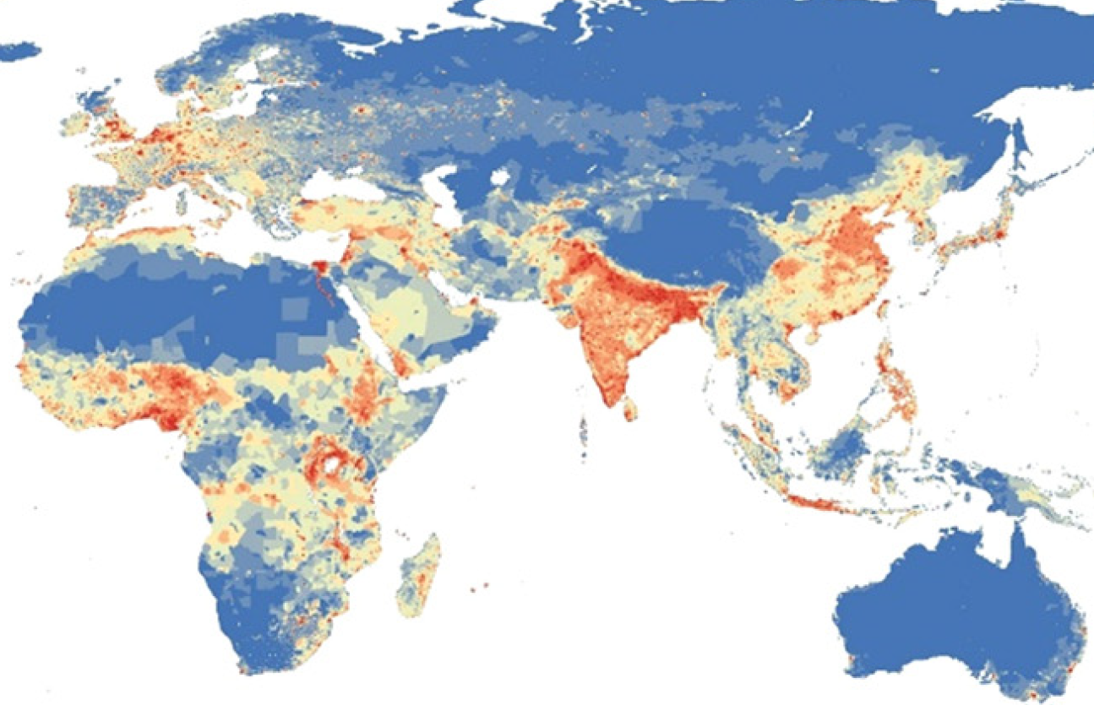
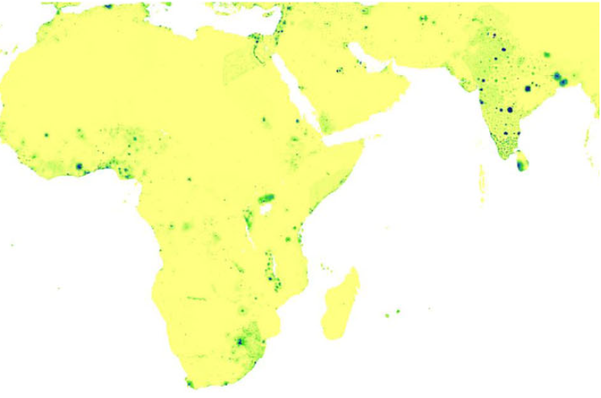
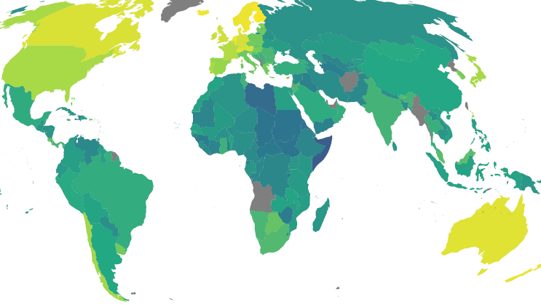
Examples of SSP extensions
Income distribution
Spatial population
Spatial urban land
Governance
Health
Oceans
Forestry
Air pollution
Water
Regions: Europe, US Southeast, Japan
Number of people in poverty
Population density
Urban land density
Governance index

Slide 26
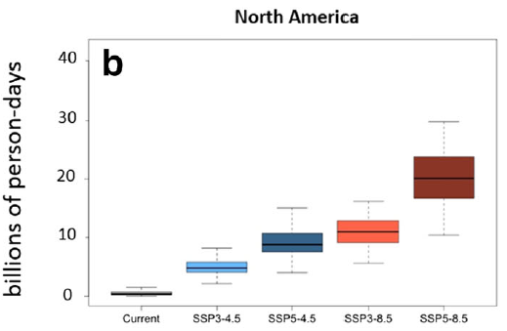
Example: Exposure to extreme heat
Two RCPs (8.5, 4.5) for climate futures
CESM ensemble simulations
Two SSPs (3, 5)
Low, high population growth
Can translate to:
Temperature level (3.7, 2.5 C global mean warming)
Time period (2061-2080)
RCP4.5
RCP8.5
SSP3
SSP5
SSP3
SSP5
Jones et al., 2018.

Slide 27
Needs and next steps

Slide 28
Selected needs and recommendations
Modify current framework
Extend SSPs to include additional indicators of vulnerability and resilience
Extend SSPs to better support adaptation pathway development
Improve scenario development process
Make process more inclusive
Establish regular update process
Connect to users and other research communities
Develop sanctioned regional scenarios
Further develop and maintain the SSP-literature database
New Research
Evaluate uncertainty range, possible missing scenarios
How to best account for possible future shocks
O’Neill et al., 2020.

Slide 29
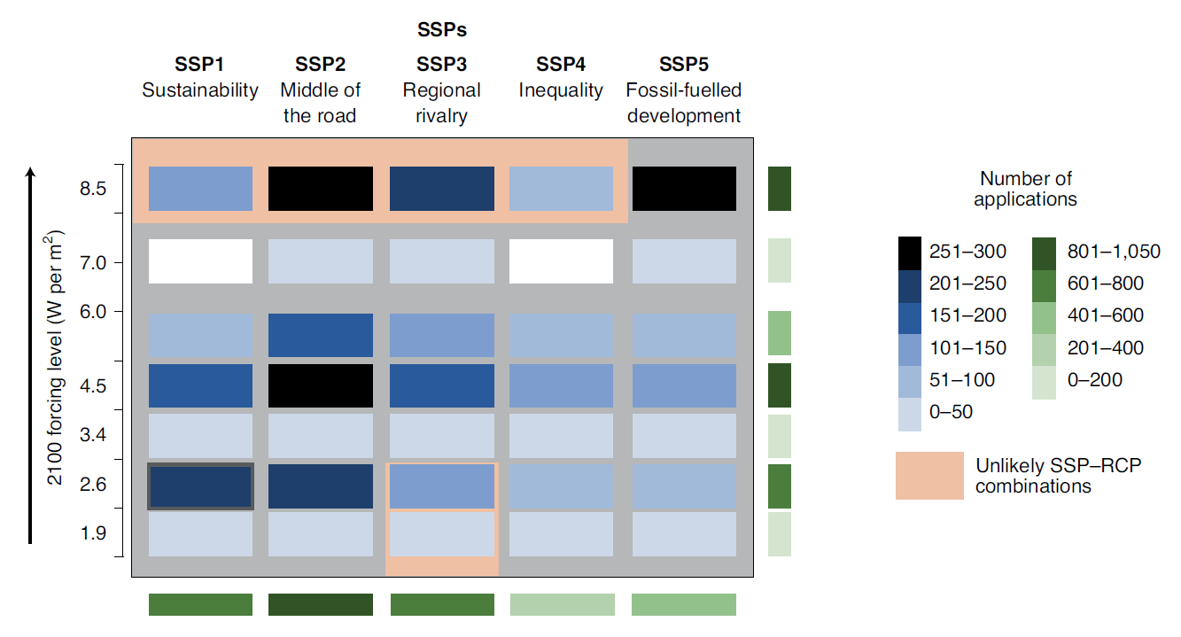
SSP applications in the literature, 2014-2019
O’Neill et al., 2020.

Slide 30
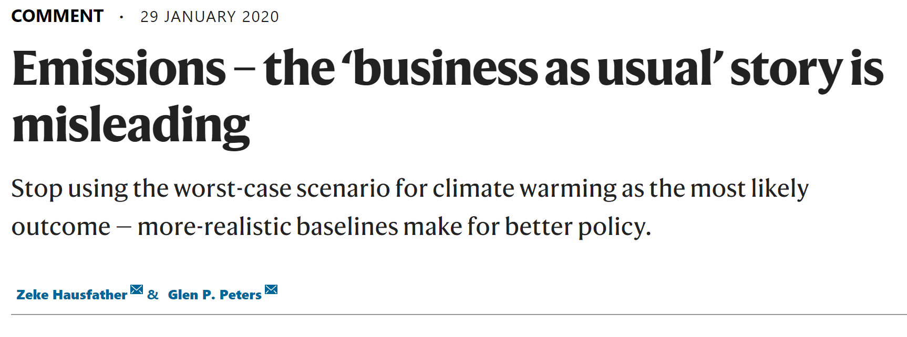
Scenario use (& misuse?)

Slide 31
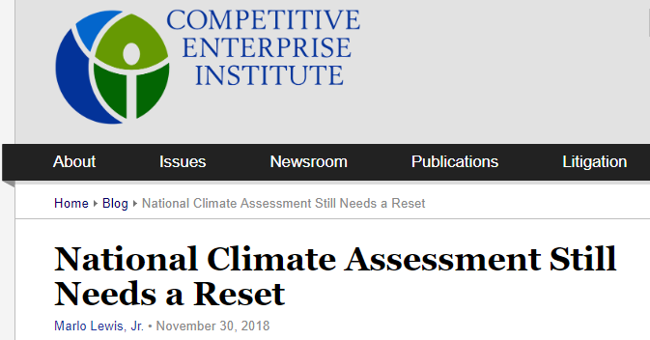
Scenario uncertainty and political debate

Slide 32
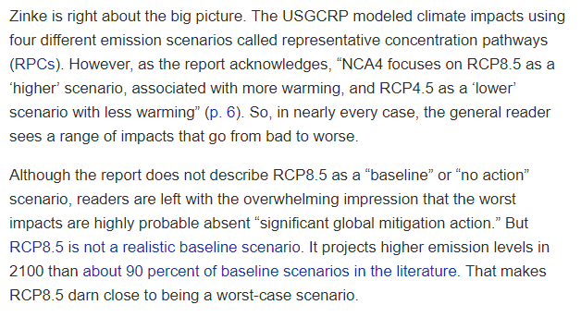
Lewis, 2018, CEI.

Slide 33
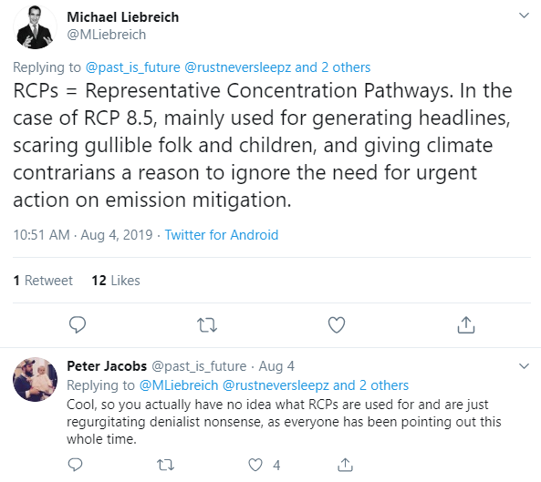
Twitter thread literally went on for weeks!

Slide 34
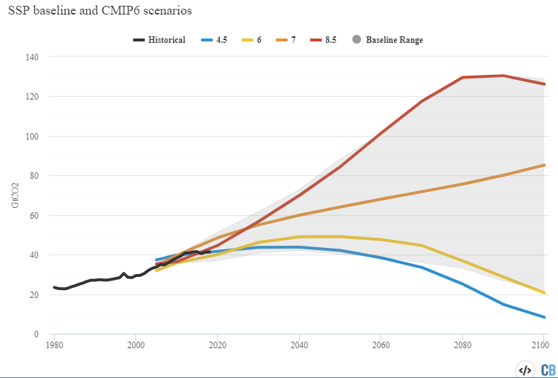
SSP5-8.5
SSP3-7.0
SSP2-4.5
SSP1-2.6

Slide 35
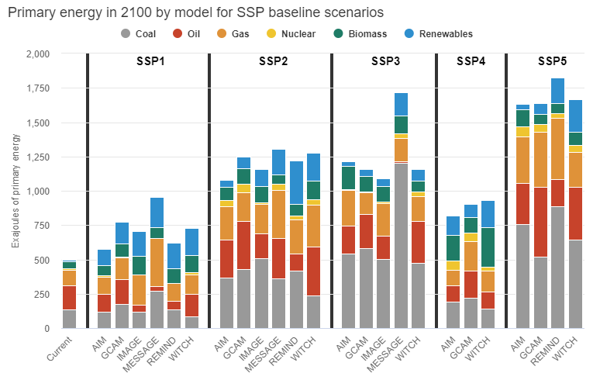

Slide 36
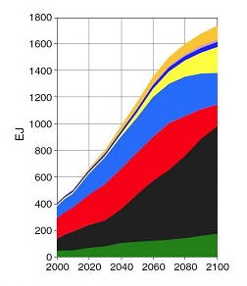
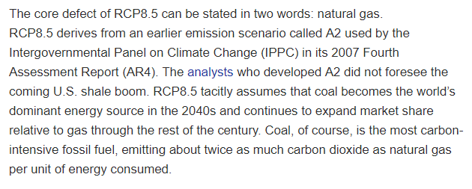
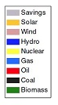
RCP 8.5 Energy supply
Lewis, 2018, CEI.

Slide 37
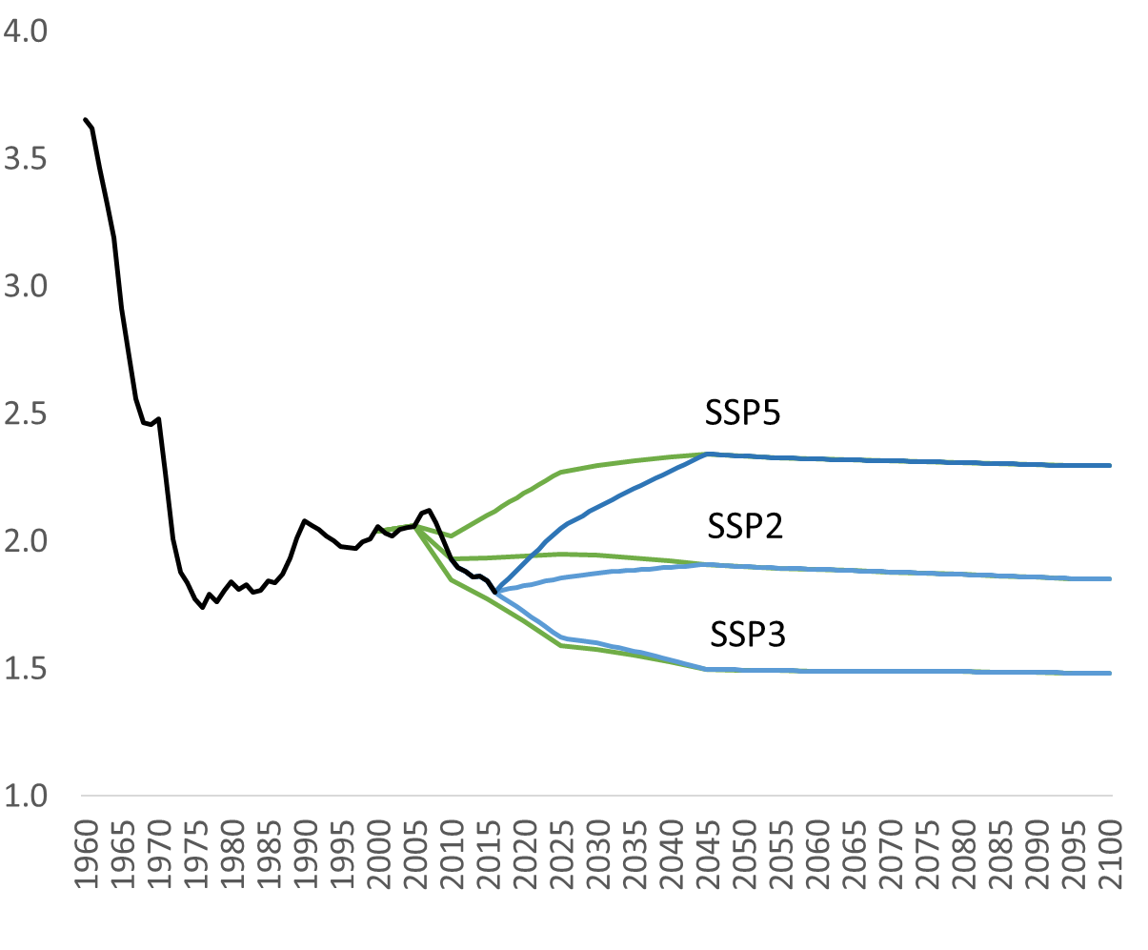
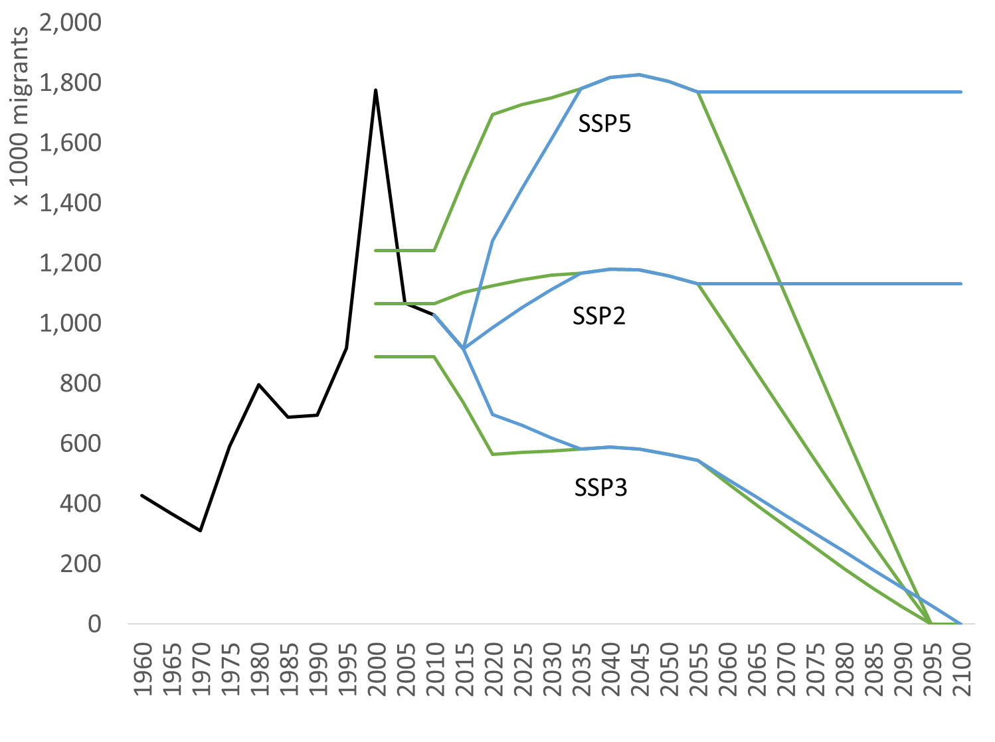
Updating US population projections
Total Fertility Rates
Net International Migrants

Slide 38
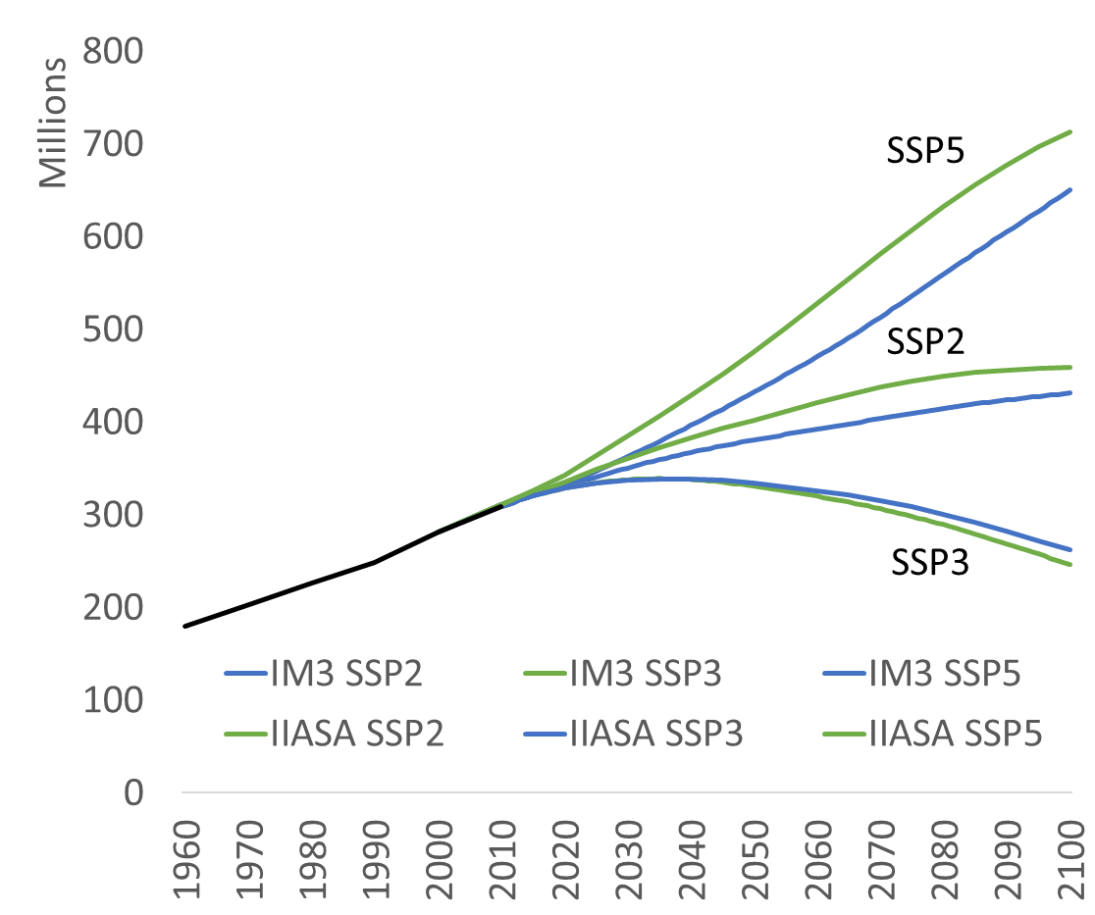
Results: US Total Population
IIASA SSP
IM3 projection
Historical

Slide 40
Extra slides

Slide 41
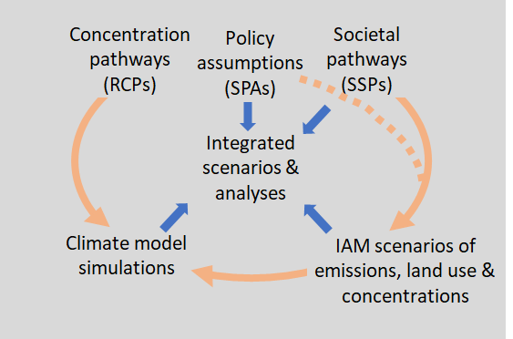
The SSP-RCP scenarios framework
O’Neill et al., 2020.

Slide 42
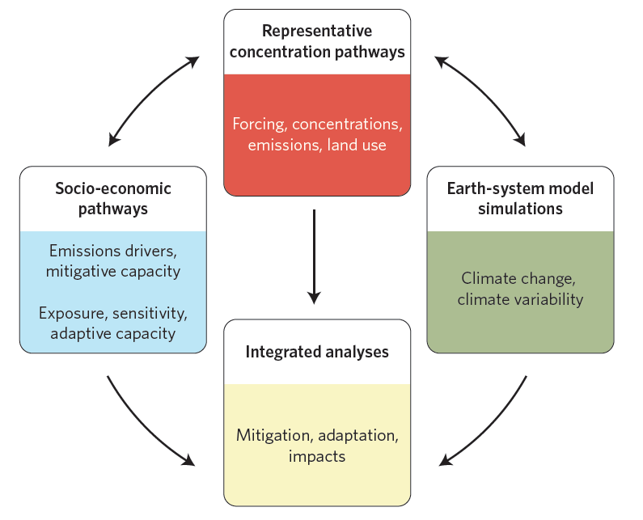
The Parallel Process
Climate change
(CMIP)
Integrated scenario-based research and assessment
IPCC, IPBES, GEO,
Assessment
Atmospheric concentrations
(RCPs)
Shared Socioeconomic Pathways (SSPs)
Adapted from Moss et al., 2010; O’Neill & Schweizer, 2011; IPCC Expt Mtg Rept 2015.

Slide 43
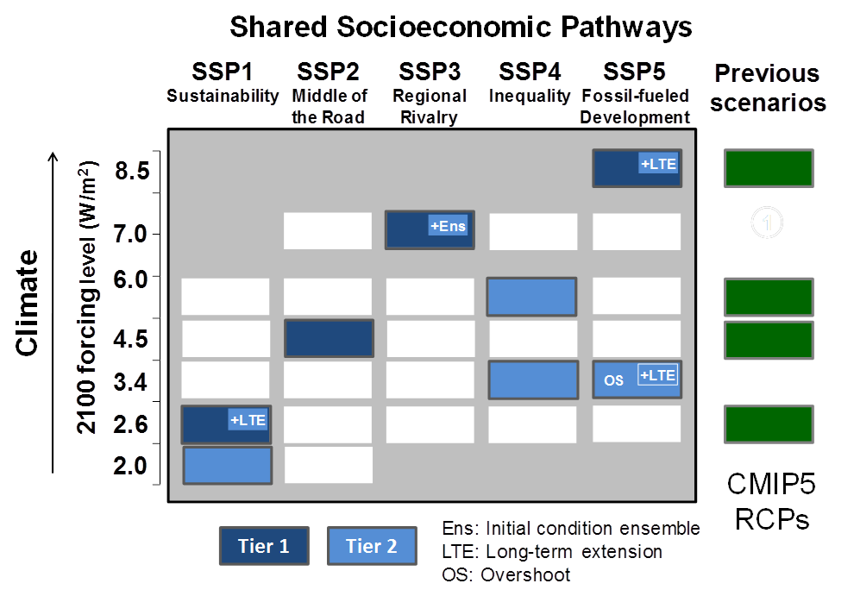
ScenarioMIP design, O‘Neill et al. (2016)

Slide 44
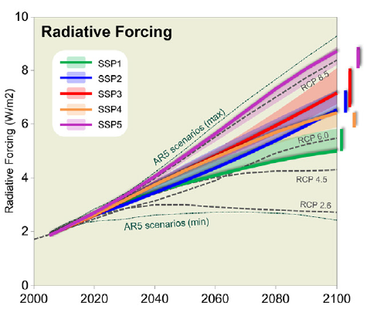
IAM scenarios based on SSPs and policy assumptions
Radiative Forcing
Selected SSP-based marker scenarios
Radiative Forcing (W/m2)
Riahi et al., 2017.
O’Neill et al., 2016.

Slide 45
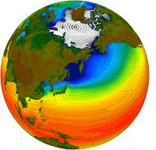
Applications: Climate projections (CMIP6)
ESMs
Selected SSP-based marker scenarios
Climate Projections
Radiative Forcing (W/m2)
“ScenarioMIP”
O’Neill et al., 2016.

Slide 46
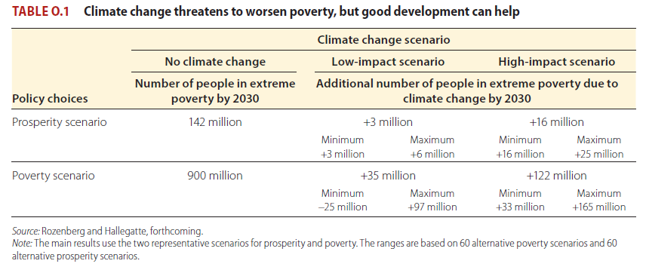
Poverty results (extr. poverty = <$1.90/day)
Current: 700 million
3%, WB goal
11%

